Slide 1
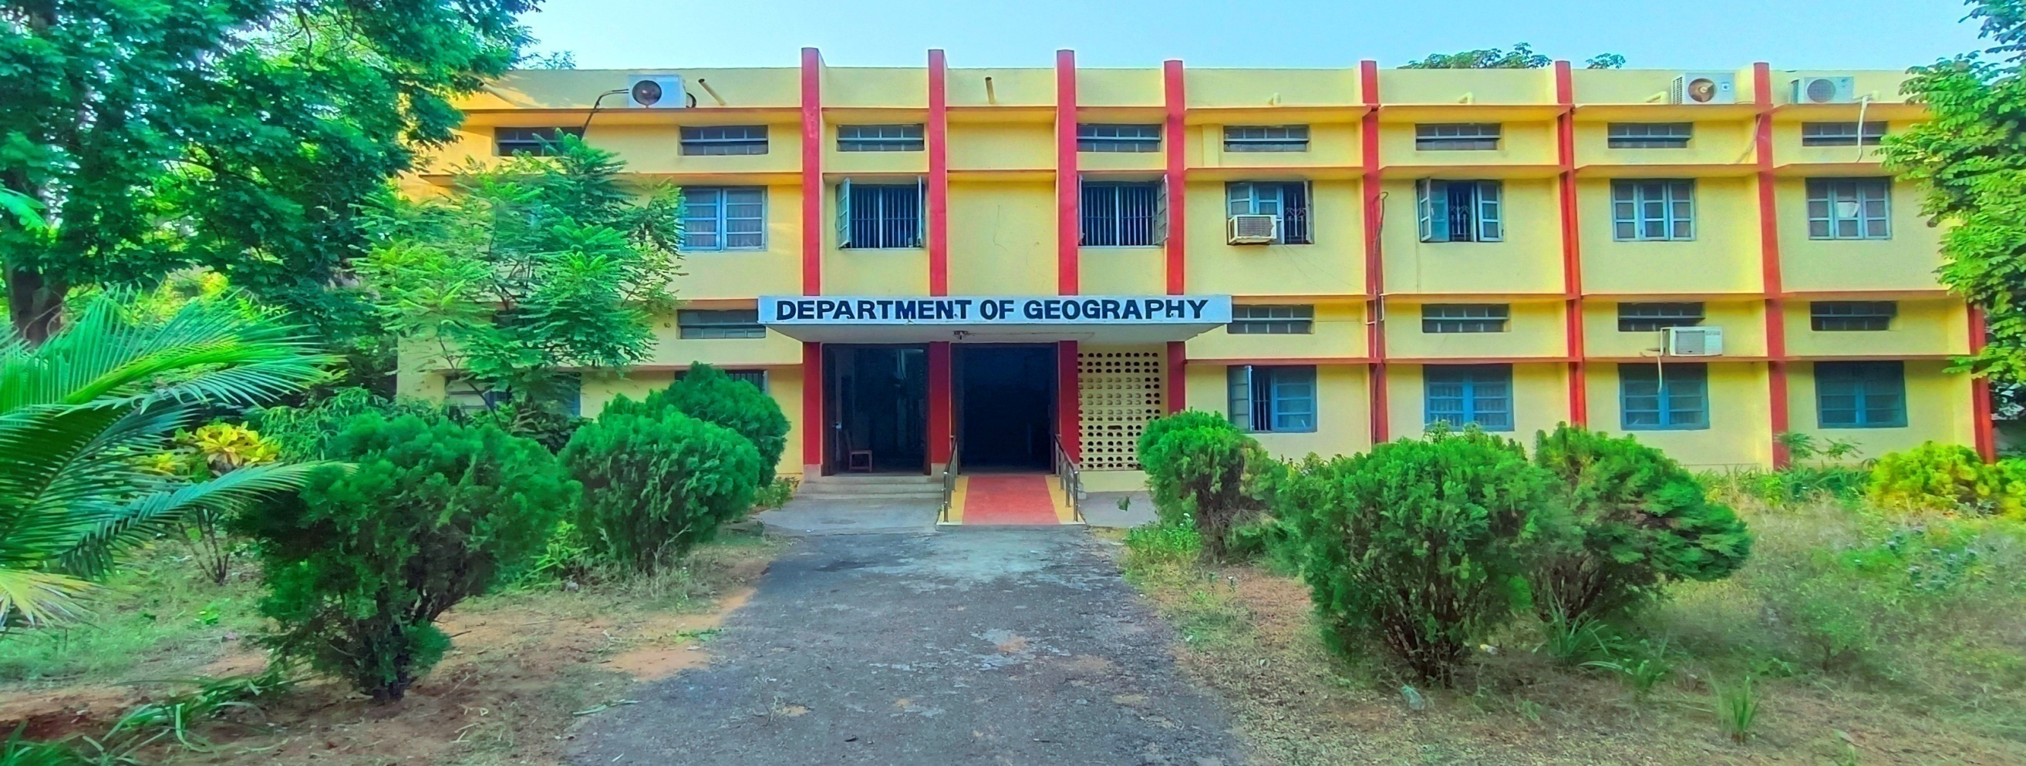
WELCOME TO
NAAC PEER TEAM 2023
Andhra University, Visakhapatnam
Department of Geography

Slide 2
OVERVIEW
• Vision & Mission
• Department Profile/History/Achievement
• Curricular Aspects
• Teaching & learning
• Research, Innovation and Extensions
• Students support and Progression
• Infrastructure and learning resources
• Institutional values and best practices
• Progressive Plan

Slide 3
VISION
To generate professional manpower with geospatial analytical expertise to scientifically explore solutions for sustainable development
MISSION
To facilitate learning through a well designed curriculum that support the optimal level of performance.
To impart training so as to operate multi disciplinary tasks through holistic approaches.
To effectuate integrated research in the thrust areas.

Slide 4
History & Profile of the Department
The Department was started in 1972 to initiate Education and Research in the Science oriented branches of Geography.
Geography is a comprehensive discipline that integrates subjects from
Social sciences,
Natural & Physical sciences and
Technology.
It is one of the few Geography Departments in the country that focuses research in Physical Geography.

Slide 5
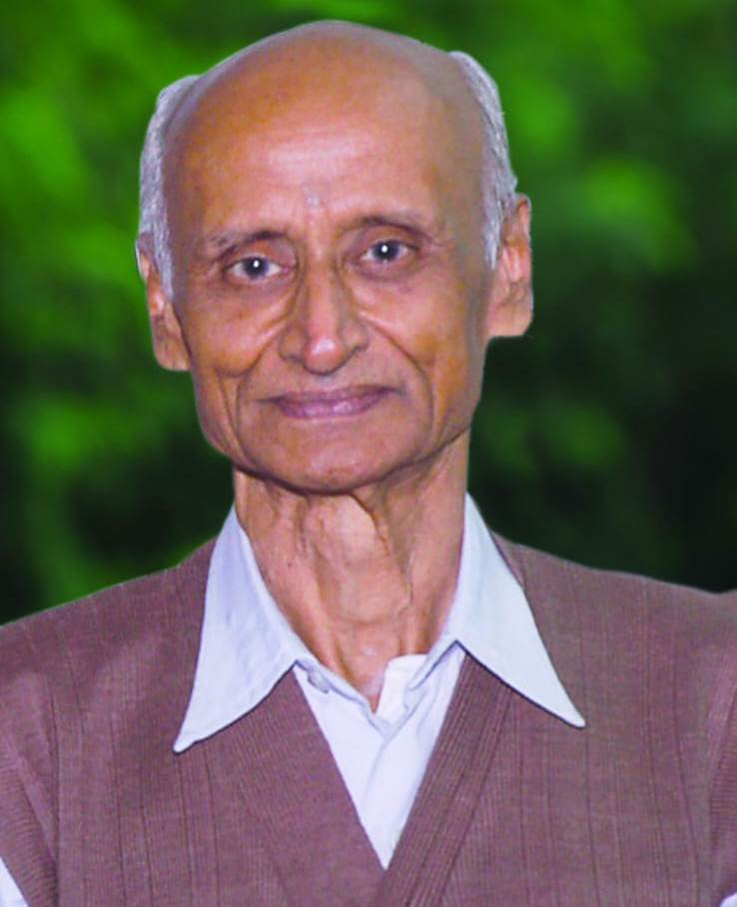
Our founder Professor is a famous Geomorphologist of National and International reputation.
Pioneered studies in
Cartography ,
Geomorphology,
Aerial Photo Interpretation,
Remote sensing methodologies
Significant Contributions:
"Geomorphic evolution of the east coast of India with special reference to deltas".
Studies on ancient channels which are potential groundwater sources.
Prof. R.Vaidyanadhan

Slide 6
The Department has eventually acquired necessary infrastructural facilities for teaching and research with funding from UGC & DST.
With UGC X Plan grants A GIS lab has been Developed in 2004.
The Department received a grant of Rs. 20,00,000/- from UGC during 2009-2011 under Non-SAP for infrastructure development.
ARC GIS and ERDAS Imagine software licenses have been procured with the above grant.
Department received Rs. 50,00,000/ under DST- FIST Scheme.
A Full fledged Central Computer lab with 16 systems, a Workstation and Photogrammetry kits has been established.

Slide 7
Achievements
Dr. Y.V.N.Krishna Murthy | Former Director – NRSC, Former Scientific Secretary, ISRO, Sr.Professor and Registrar IIST, Thiruvananthapuram
Sri. D. Pampathi Reddy (IAS-1985 batch) Reputed research/ academic organisations Several Universities Private sector organisations | Principal Secretary, Finance (Punjab Cadre) NRSC, ISRO, ADRIN, IITM, IMD, APSAC and India and abroad TCS, INFOSIS, INFOTECH, ROLTA INDIA, RSI, IIC, NAVIONICS, SPECK SYSTEM etc.

Slide 8
Programmes
M. Sc. Geography
Ph.D.

Slide 9
Curriculum
SEMESTER | PAPER CODE | CORE/ ELECTIVE | TITLE
FIRST | Gr 101 | Core Paper 1 | Geomorphology
 | Gr 102 | Core paper 2 | Economic Geography
 | Gr 103 | Core Paper 3 | Geography of India and
 |  |  | Andhra Pradesh
 | Gr 104 | Core Paper 4 | Principles of Cartography
 | Gr 105 | Practical 1 | Map Analysis
 | Gr 106 | Practical 2 | Cartography
SECOND | Gr 201 | Core paper 1 | Climatology and Oceanography
 | Gr 202 | Core Paper 2 | Geographical Thought
 | Gr 203 | Core Paper 3 | Urban Geography
 | Gr 204 | Core Paper 4 | Principals of Remote Sensing
 | Gr 205 | Practical 1 | Interpretation of Arial Photographs
 | Gr 206 | Practical 2 | Climatic Data Analysis

Slide 10
SEMESTER | PAPER CODE | CORE/ ELECTIVE | TITLE
THIRD | Gr 301 | Core Paper 1 | Population Geography
 | Gr 302 | Core Paper 2 | Environmental Geography
 | Gr303-A | Elective Paper – 1 | A. Pedology & Hydrology
 | Gr303-B |  | B. Applied Climatology
 | Gr303-C |  | C. Geography of Health
 | Gr 304-A | Elective Paper- 2 | A. Disaster Management Studies
 | Gr 304-B |  | B. Geography of transportation
 | Gr 304-C |  | C. Cultural Geography
 | Gr 305 | Practical 1 | Quantitative Techniques in Geography
 | Gr 306 | Practical 2 | Image processing
 | Gr 307 | MOOCs
 | Gr 408 | Intellectual
 |  | Property Rights (IPR)

Slide 11
SEMESTER | PAPER CODE | CORE/ ELECTIVE | TITLE
FOURTH | Gr 401 | Core paper 1 | Regional Planning And Development
 | Gr 402 | Core paper 2 | Geographic Information Systems
 | Gr 403- A | Elective Paper | A. Agricultural Geography
 |  |  | B. Biogeography
 | Gr 403 -B
 |  |  | C. Political Geography
 | Gr 403-C
 | Gr 404 | Project Work | Dissertation & Viva-voce
 | Gr 405 | Practical 1 | Terrain Analysis
 | Gr 406 | Practical 2 | Geographic Information Systems
 | Gr 407 | MOOCs
 | Gr 408 | Value Added Course

Slide 12
Integration of Environmental Sustainability in the Curriculum
Environmental Geography
Disaster Management Studies
Economic Geography
Geography of Health
Population Geography
Urban Geography
Agricultural Geography
Climatology & Oceanography
Geomorphology
Geographic Information Systems

Slide 13
Courses having employability
Code Gr 104 Principles of Cartography
Code Gr 204 Principles of Remote Sensing
Code Gr 205 Interpretation of Aerial Photographs
Code Gr 301 Population Geography
Code Gr 302 Environmental Geography
Code Gr 304 Disaster Management Studies
Code Gr 401 Regional Planning and Development
Code Gr 402 Geographic Information Systems

Slide 14
Courses having entrepreneurship
Code Gr 105 Map Analysis
Code Gr 106 Cartography
Code Gr 205 Interpretation of Aerial Photographs
Code Gr 206 Climatic data analysis
Code Gr 305 Quantitative Techniques in Geography
Code Gr 306 Image Processing
Code Gr 402 Geographic Information Systems
Code Gr 405 Terrain analysis
Code Gr 406 Geographic Information Systems

Slide 15
Courses having skill development.
Code Gr106 Cartography
Code Gr205 Interpretation of Aerial Photographs
Code Gr306 Image Processing
Code Gr404 Project work (Dissertation & Viva – Voce)
Code Gr 405 Terrain analysis
Code Gr 406 Geographic Information Systems

Slide 16
Student`s Projects
Project work is mandatory for all the Fourth Semester students
Each student is allowed to choose a field work oriented topic for
the project duly guided by the faculty.
Students have to collect appropriate
Primary and/or Secondary data
apply suitable analytical techniques
Draft and submit the dissertation

Slide 17
Feedback for curriculum has been collected from the
following stake holders and analysed
Students
Faculty
Alumni
Parents
Most of them are in strong agreement with all the parameters

Slide 18
PROGRAMME OUTCOMES (POs):
PO1 Sound knowledge about the earth’s physical and biospheres and their interactions.
PO2 Understanding of the philosophy of geography and the components of human geography- demographic, socio economic, political and geographic characteristics of the world and India in particular.
PO3 Understanding of the distribution of economic activity and resources, their utilization and sustainable management
PO4 Data analysis, map making and interpretation skills
PO5 Introduce the geospatial technologies and their applications.

Slide 19
Course Out Comes Mapping of Cos & POs

Slide 23
Gender diversity of Students
Year | Strength | Male | Female
2017 | 26 | 24 | 02
2018 | 28 | 21 | 07
2019 | 33 | 23 | 10
2020 | 27 | 19 | 08
2021 | 15 | 09 | 06
2022 | 13 | 07 | 06

Slide 24
Students Diversity
Year | Strength | SC | ST | BC | OC | Foreign Students
2017 | 26 | 02 | - | 23 | 01
2018 | 28 | 10 | 01 | 16 | 01
2019 | 33 | 05 | 01 | 23 | 03
2020 | 27 | 05 | 03 | 17 | 02
2021 | 15 | 03 | -- | 11 | -- | (1) Ghana
2022 | 13 | 05 | 01 | 04 | 02 | (1) Lesotho

Slide 25
Results Analysis
Year | Pass % | A | B | C
2017 | 100 | 4 | 7 | 26
2018 | 93 | 50 | 43 | --
2019 | 90 | 50 | 20 | 20
2020 | 94 | 69 | 25 | --
2021 | 90 | 25 | 65 | --
2022 | 88 | 31 | 58 | --

Slide 26
Results Analysis
Year | Pass % | A | B | C
2017 | 100 | 4 | 7 | 26
2018 | 93 | 50 | 43 | --
2019 | 90 | 50 | 20 | 20
2020 | 94 | 69 | 25 | --
2021 | 90 | 25 | 65 | --
2022 | 88 | 31 | 58 | --

Slide 27
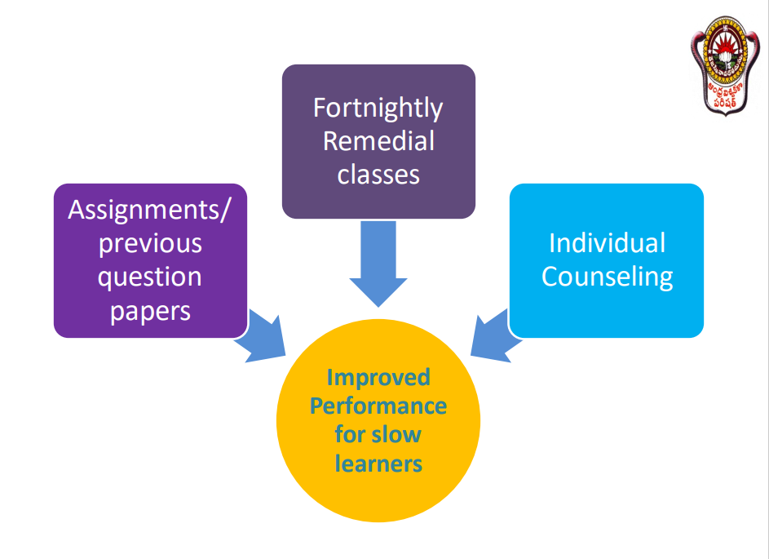

Slide 28
SLOW LEARNER
ADVANCED LEARNERS
S. NO | NAME OF THE STUDENT | REGISTER NO
1 | DIVYA KOLA | 718210712002
S. NO | NAME OF THE STUDENT | REGISTER NO
1 | CHRISTOPHER .K | 721210712002
SPECIFIC MEASURES TAKEN
1.Remedial Classes
2.Online reading material support.
3.Teachers encourage orientation classes.
4. Mentor—Mentee Counseling.
MEASURES TAKEN
1.Online reading and material support
2. Conducting seminars and quiz weekly
3. Guidance in making power point presentation
4. Lectures on advanced topics

Slide 29
Faculty Profile
Name | Qualification | Designation | Specialization
Dr. T.V. Krishna (Vidwan-ID : 244895) | M.Sc. Ph.D | Professor | Bioclimatology, Urban, Environmental and Health Geography
Dr. P.Suneetha (Vidwan-ID : 245078) | M.Sc. Ph.D | Professor & HOD | Urban Climatology & Land Use Studies
Dr. Anuja Tigga (Vidwan-ID : 234361) | M.A. Ph.D | Professor & Chairperson BOS (PG) | Agro climatology
Dr. Hema Malini | M.Sc. Ph.D | Honorary Professor | Climatology

Slide 30
ADMINISTRATIVE EXPERIENCE
Prof.T.V.Krishna | Prof.P.Suneetha | Prof.Anuja Tigga
HOD, Geography, AU (2005-208, 2014-17, 2020 – 21) Chairman, BOS (PG)(2013-14, 2017 -20) Warden, Science Hostels, AU (2000-04) Chief Warden, Boys Hostels (2004 -2008) Director, Security & Sanitary Unit (2008-16) Member, Academic Senate, AU (2013-14) Honorary Director, Press & Publications, AU (2016-22) Director, Human Resources Development Centre, AU (2023 – till date) | HOD Geography, AU (2008-11, 2021- till date) Chairperson, BOS (PG) (2018-21) Asst. Principal, AUCST (2012-15) Chief Warden, AULH (2016-21) (Warden 1996-98) | HOD, Geography (2017-20) Chairperson (2021-till date) Internal Auditor, AU (2018-till date)

Slide 31
Faculty Awards
Name | Award | Conferred by
Prof. B. Hema Malini | Geography Researchers Award - 2012 | Deccan Geographical Society, Pune
Prof. B. Hema Malini | Bhoogol Bhuyshan Award - 2019 | Deccan Geographical Society, Pune
Prof. Anuja Tigga | Best paper Presenter Award - 2022 | International Geographical Union, Thematic Conference, CU of Haryana

Slide 32
Faculty Fellowships
Prof. B. Hemamalini
Sl No | Fellowships Received Cadre | Service
 |  | From | To
1 | ICSSR Senior Fellow | 2019 | 2021
2 | UGC Emeritus | 2016 | 2018
3 | UGC Emeritus | 2015 | 2016

Slide 33
Recognitions
Prof.B. Hema Malini
Editorial board member of Journals
1.The Deccan Geographer
2. Punjab Geographer
Positions in Associations
President NAGI 2020 - 23

Slide 34
Faculty Membership in Professional Bodies
Institute/ Body
National Association of Geographers of India (NAGI)
The Indian Geographical Society, Chennai
Deccan Geographical Society (DGS)
GIS India, Hyderabad
Institute of Indian Geographers (IIG)
Union of Geographic Information Technologists (UGIT)
Association of Punjab Geographers (APG)
Association of Population Geographers of India
The Geographical Society of India,
Indian Society of Geomatics
Indian Meteorological Society
Geographical Society of Uttarakhand
Association of Hydrologists of India, Visakhapatnam
Membership in Editorial Boards of various journals

Slide 35
Awards Instituted by Prof. B. Hema Malini
SL No | Name of the Award | Association
1 | Young Geographer Award | Deccan Geographical Society, Pune
2 | Eminent Geographer Award | National Association of Geographers India, Delhi
3 | Promising Geographer Award | Association of Punjab Geographers

Slide 36
AWARDS
Prof.R.Vaidyanadhan Shastyabdipoorthi Prize
Prof.Rajagopala Vaidyanadhan Studentship

Slide 37
Research Activity
PH.D Degrees Awarded 71 LIST OF Ph.Ds and M.Phils.docx
M.Phil Degrees awarded 20 LIST OF Ph.Ds and M.Phils.docx
Working 11
Post Doctoral Fellow’s 07 PDFs.docx
Scholarships 05 fellowships rs.pptx
UGC-NET/ICSSR/RGNF
Research projects 32 RESEARCH PROJECTS CONDUCTED.docx
Seminars Organized 13 SEMINARS.docx
Publications 269 TOTAL PUBLICATIONS.docx

Slide 38
THRUST AREAS OF RESEARCH
Climate Change
Urban Studies
Agricultural Studies
Land Use /Cover Studies
Environmental Issues and Impact Assessment

Slide 39
Research Projects
Sl.No | Title | Funding Agency | Year
1 | Coastal Vulnerability to cyclones and storm surges at village level through assessment of geographical and socio-economic factor – A methodology development. | UGC | 2017
2 | Climate change vs. trends in weather extremities and their impact on ecosystems in Andhra Pradesh | UGC | 2018
3. | Environmental changes and Human diseases and Health care delivery system: A study on Tribal Regions of North Coastal Andhra, AP, India-2016 | ICSSR | 2018
4. | Assessment of Trends in Malaria incidence: A Case study of Visakhapatnam District, Andhra Pradesh | ICSSR | 2019
5. | Evaluation of the impact of Aquaculture on physical and Socio-Economic environment of West Godavari delta region, Andhra Pradesh using Remote Sensing and GIS | UGC | 2019
6. | Impact of changing land use/ land cover conditions on Socio-Economic status of Costal Villages- A case study of West Godavari District, AP. | ICSSR | 2021

Slide 40
Library The department’s Library has good number of text books, Atlases, Encyclopedias, census publications etc Total Number of books: 821 New books: 99

Slide 41
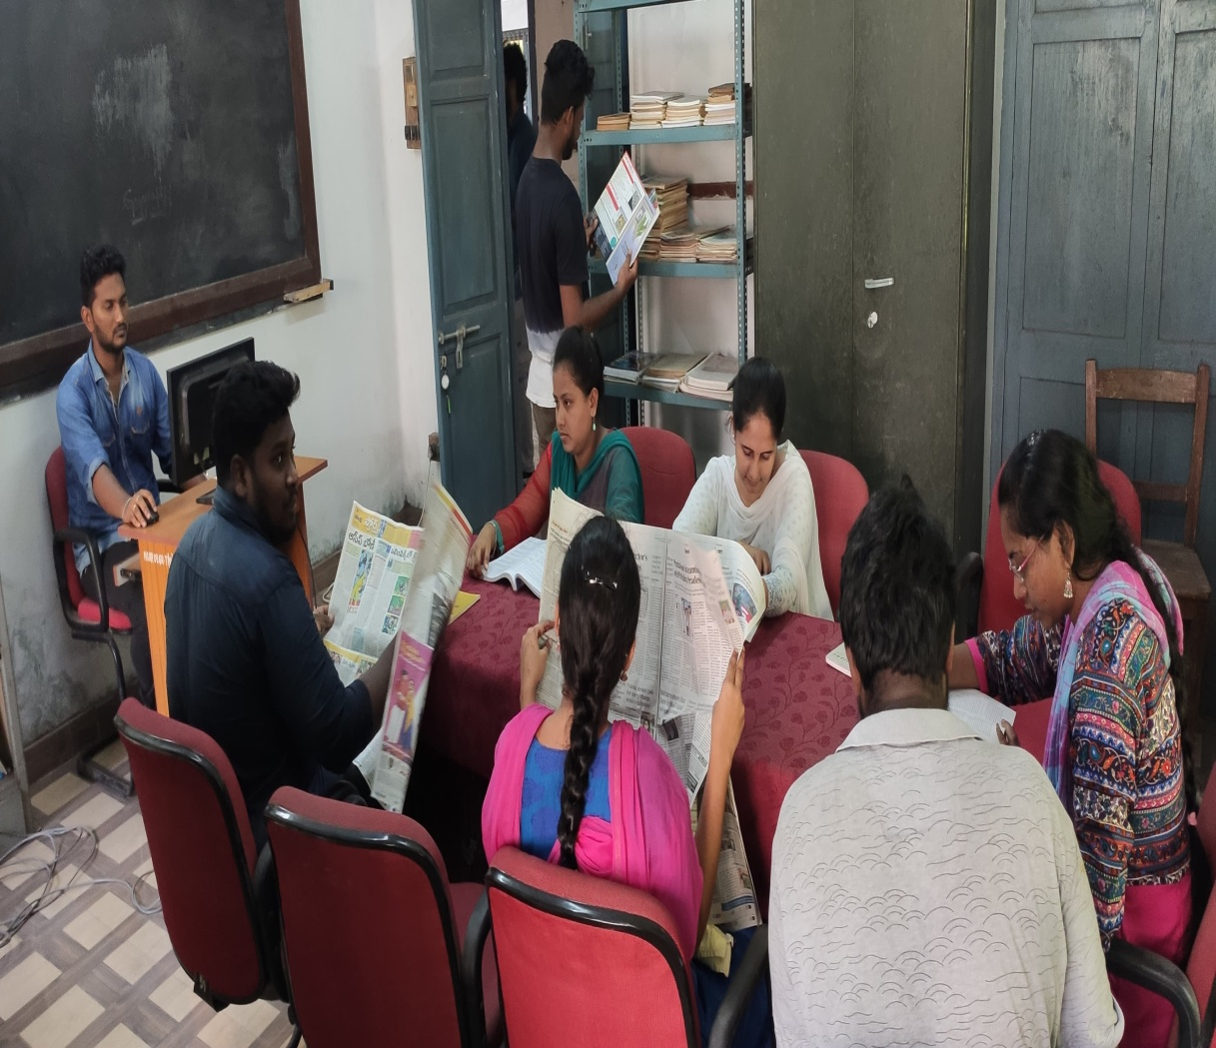
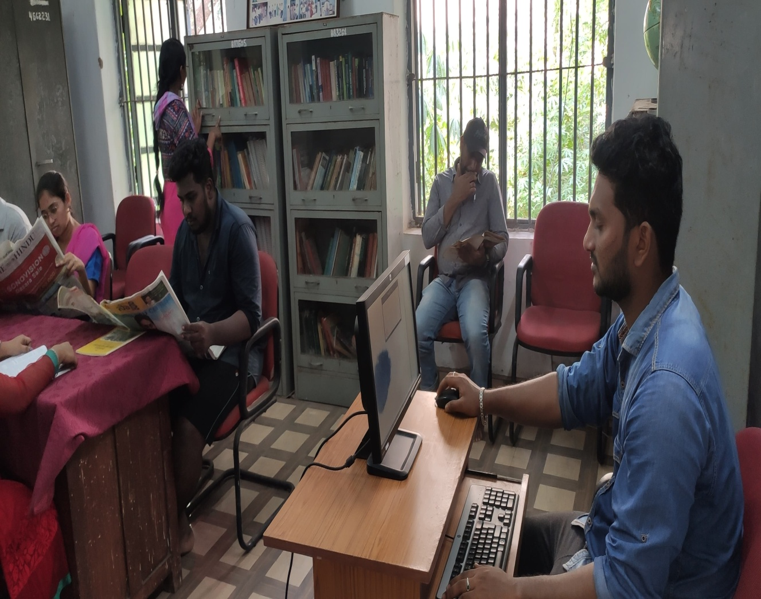
Library

Slide 42
Labs & Equipment
Cartography :
Topographic Maps, Weather Charts, Atlases and Models
Air photo Interpretation:
Stereoscopes, Arial Photos, Stereogram & Stereo pairs
GIS/Computer:
Hardware: Computers, A0 size Map Scanner & Plotter
Total Station, Handheld GPS receivers
Software: Erdas Imagine & Arc-GIS
Digital Interactive Panel

Slide 43
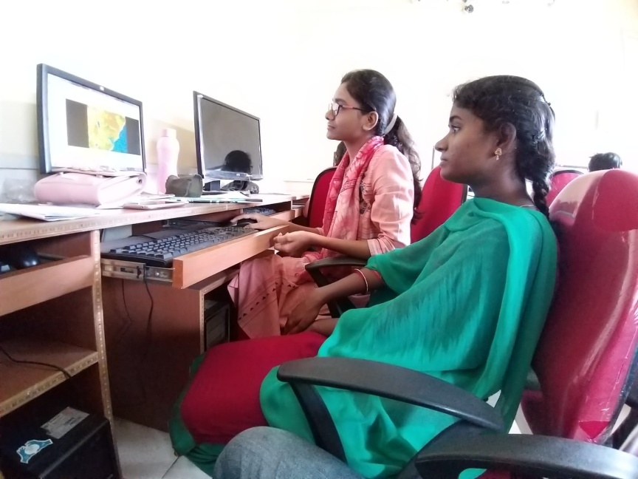
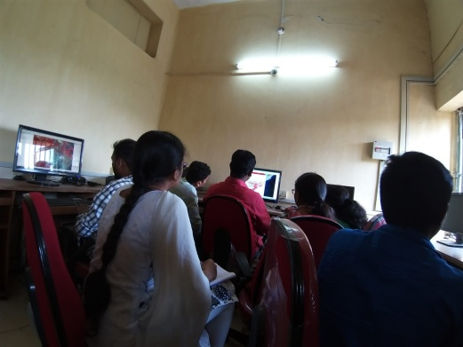
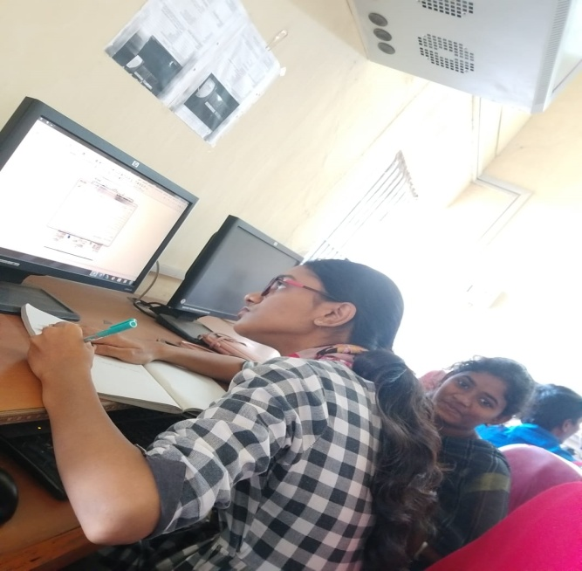
Central Computer Lab for
Image Processing & GIS

Slide 44
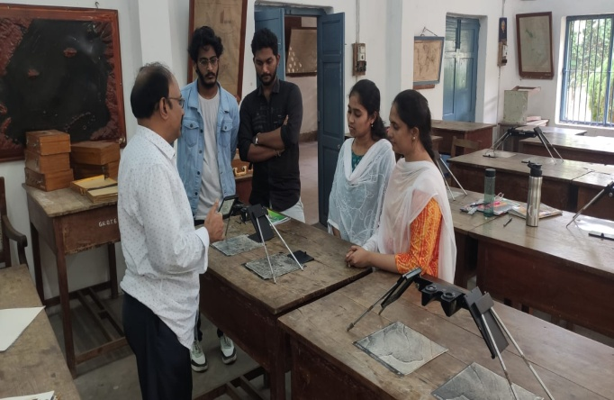
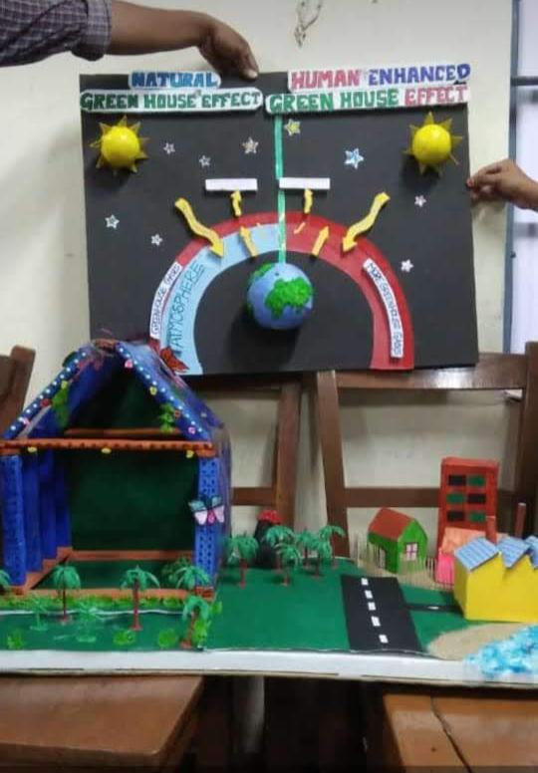
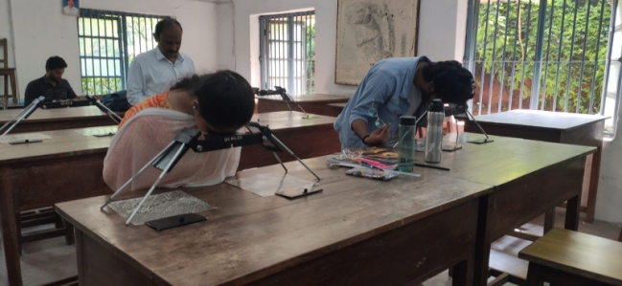
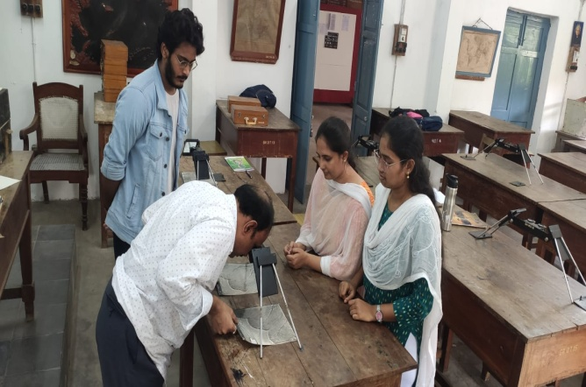
Air Photo Interpretation & Cartography Lab

Slide 45
Students Support and Guidance for
NET/SLET/GRE and other competitive examinations
Guest Lectures
Guidance provided for various competitive examinations.
Guidance provided for Projects & Seminar presentations.
Encouragement to prepare thematic maps, models.

Slide 46
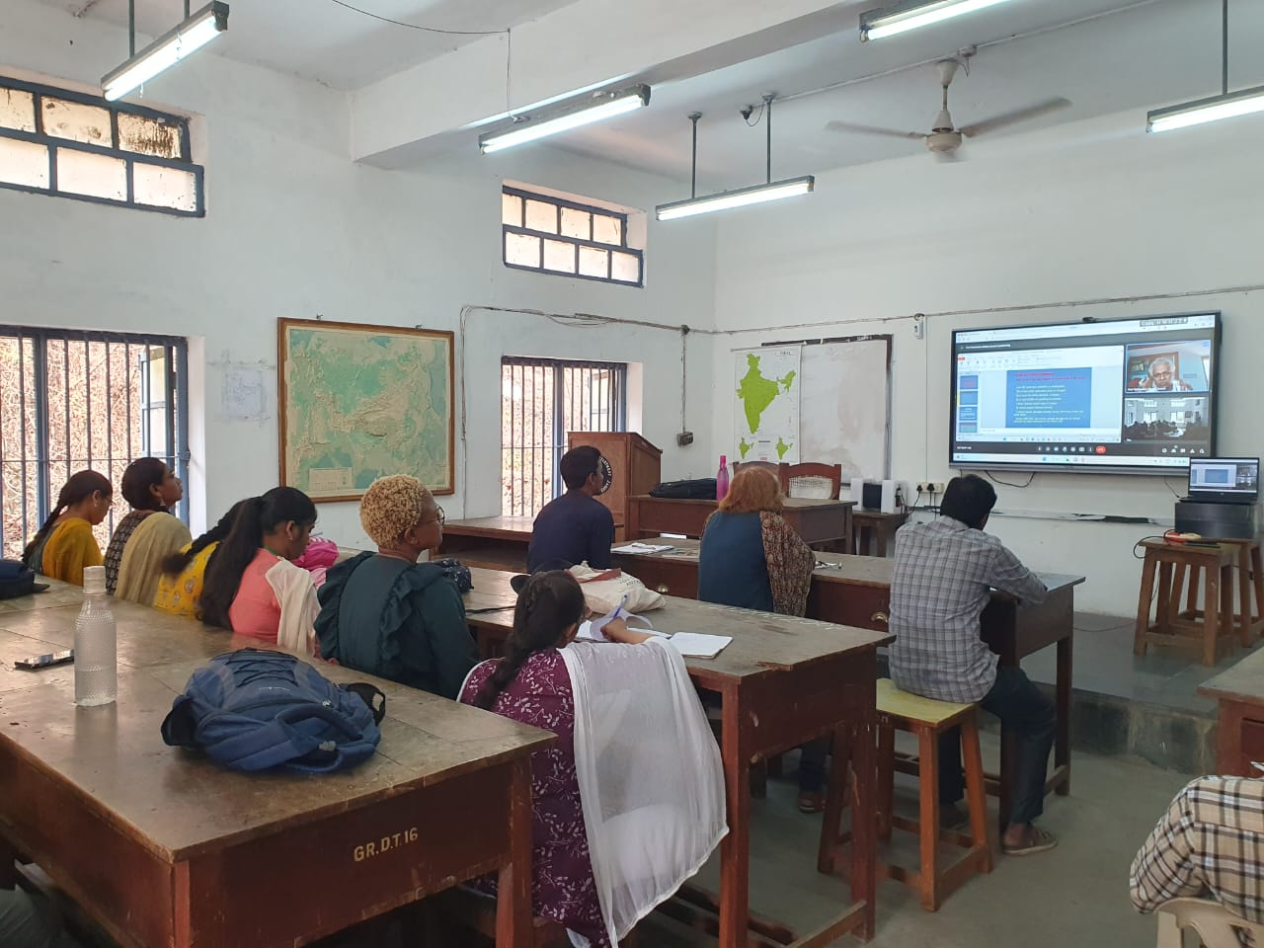
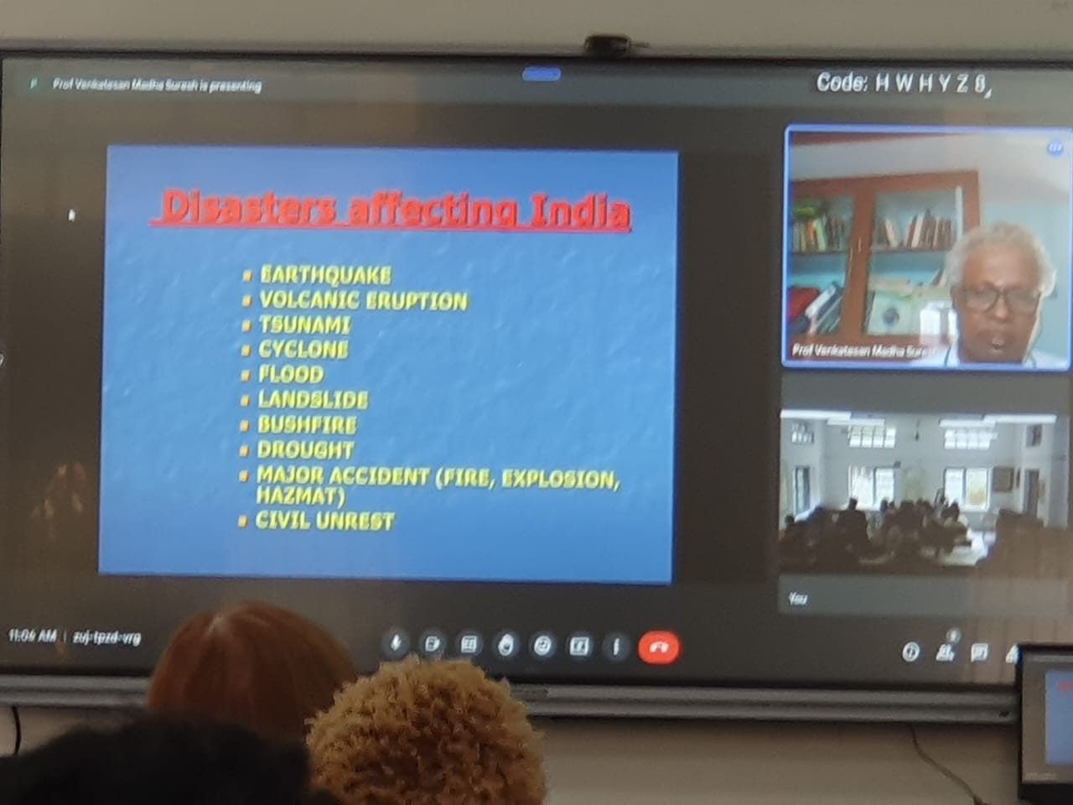
GUEST LECTURES
Prof. Madha Suresh University of Madras
Series of lectures in Applications of RS& GIS IN Disaster Management Studies

Slide 47
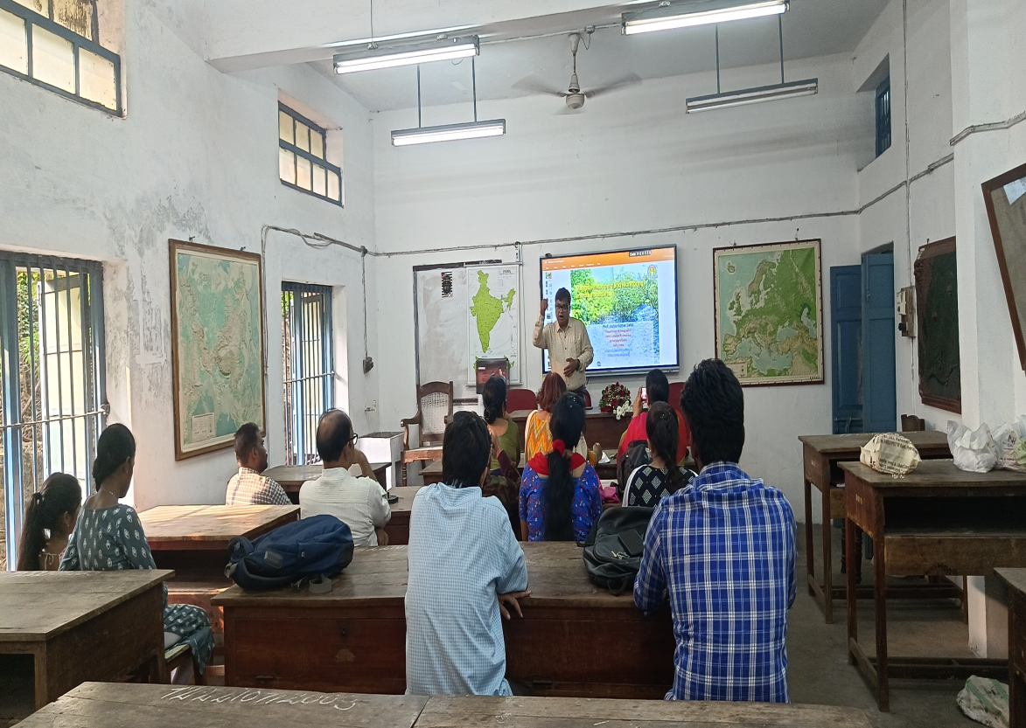
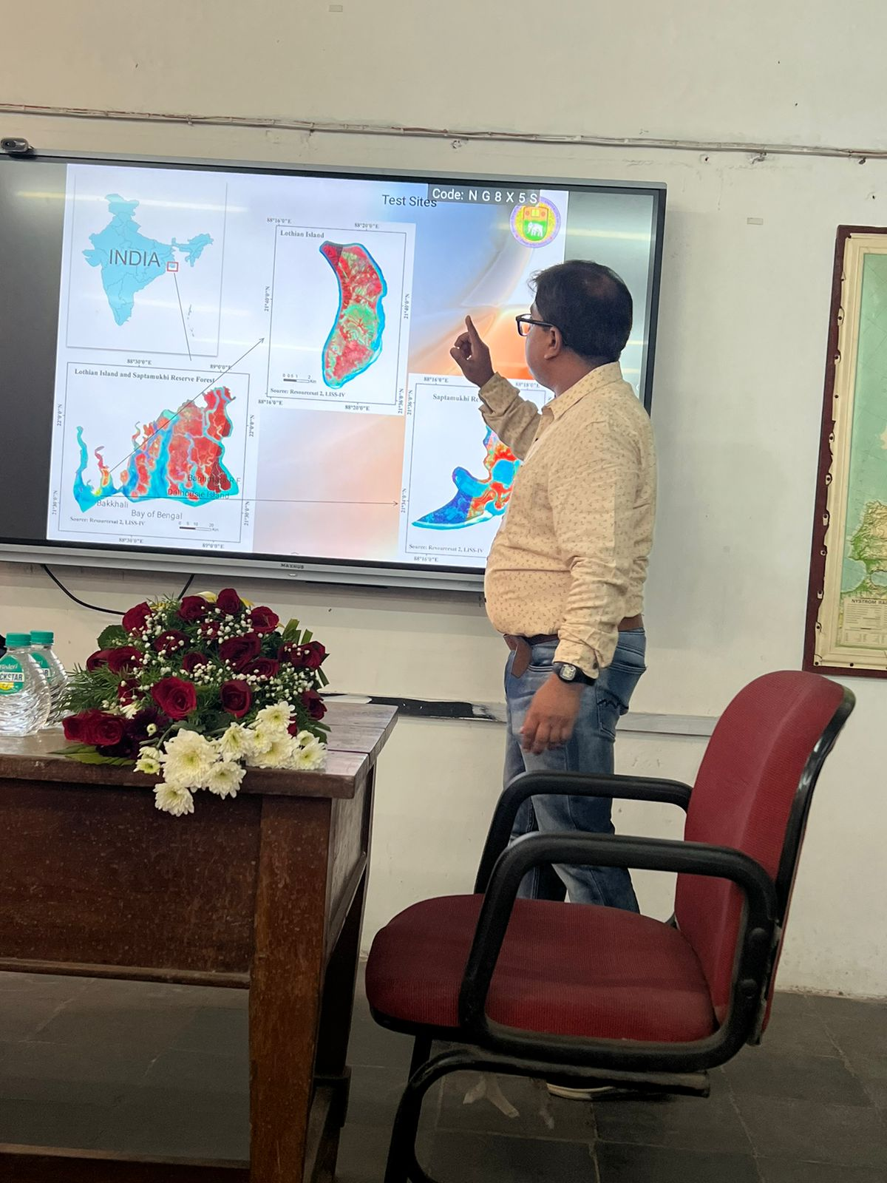
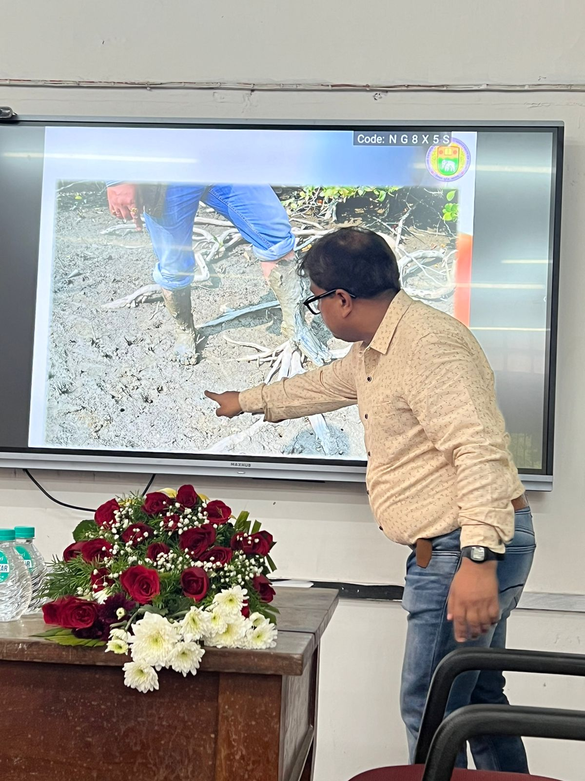
Prof. Ashis Kumar Saha, Delhi School of Economics
Mangrove Mapping and monitoring in Indian Sunderban using RS & GIS

Slide 48
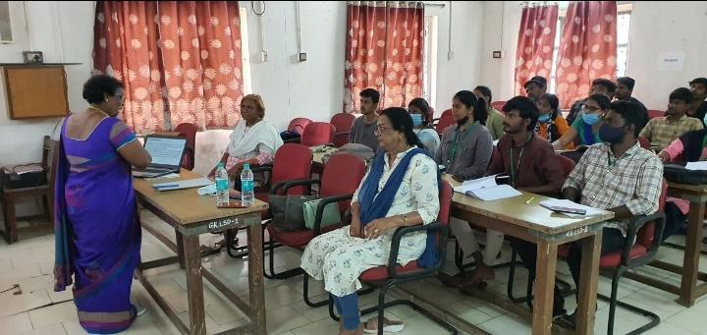
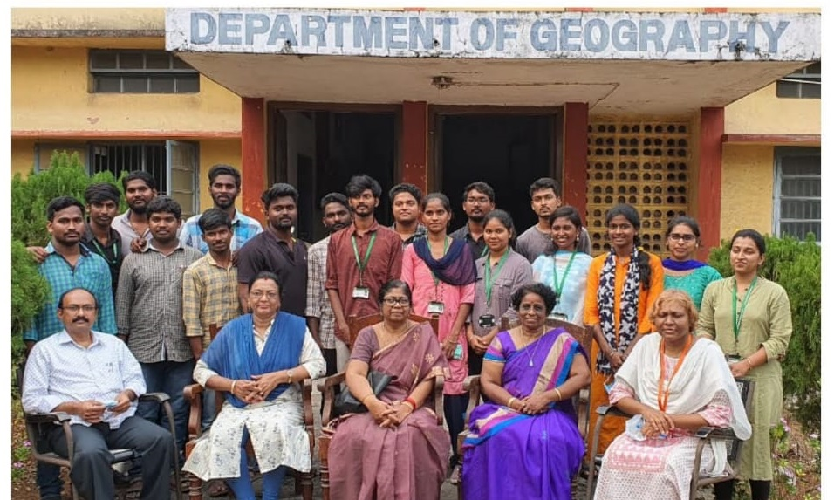
Prof. Thulasimala
University of Madras
Series of lectures in Regional planning and Development

Slide 49
Placements
Most of our Students are placed in
Educational Institutions
GIS Companies
Government services

Slide 50
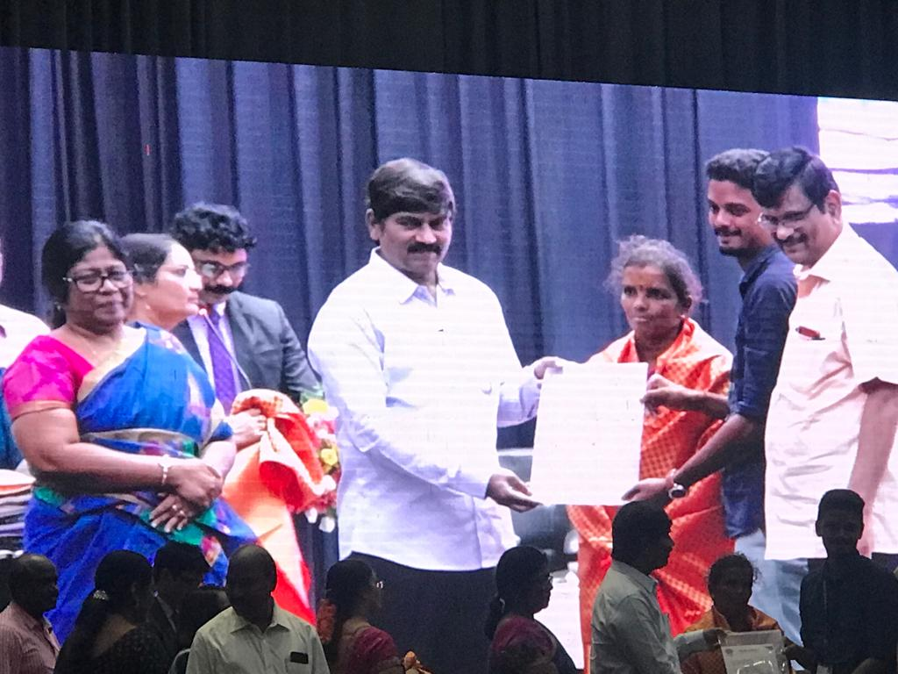
CAMPUS PLACEMENTS

Slide 51
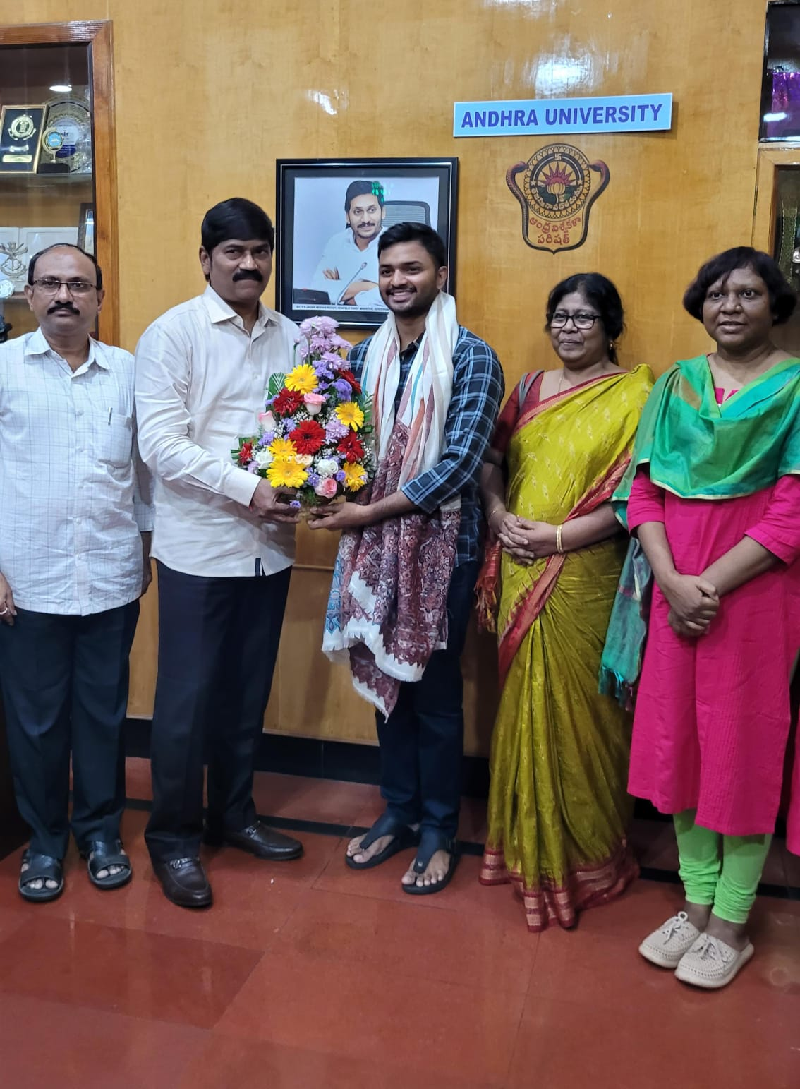
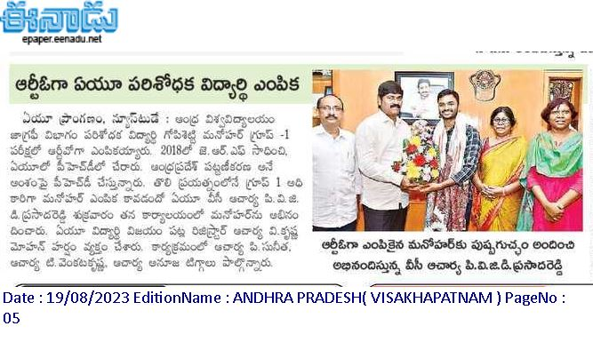
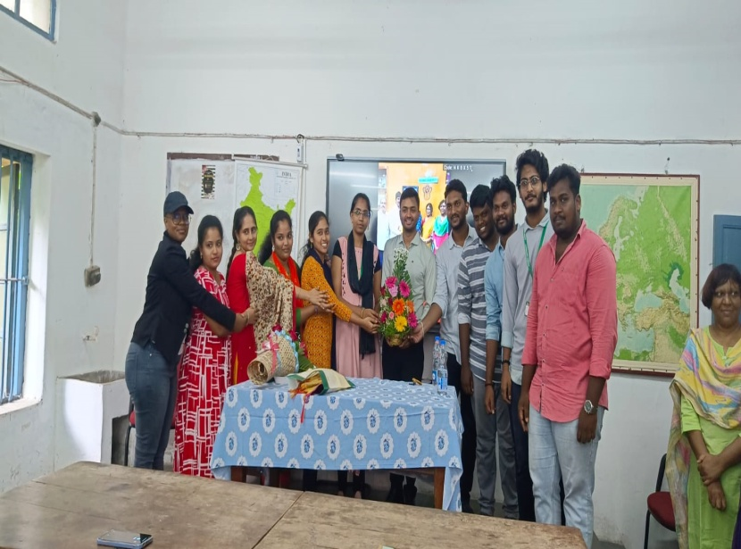
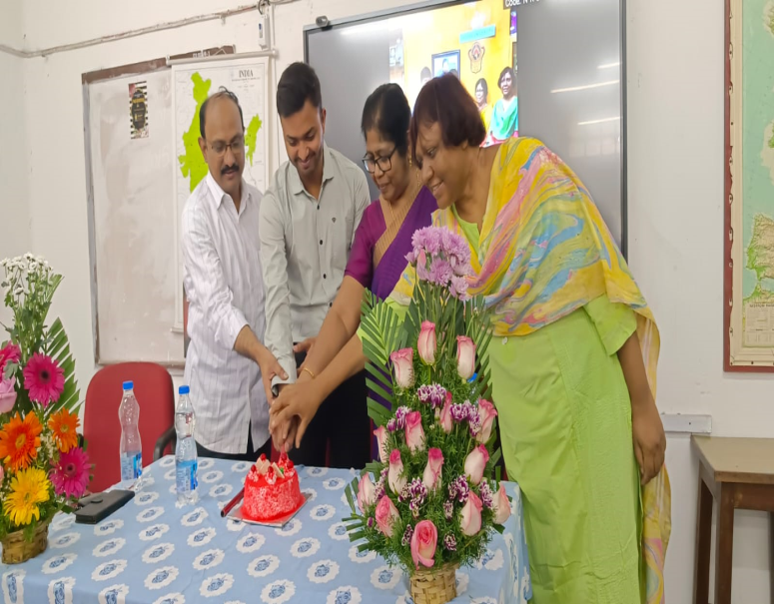
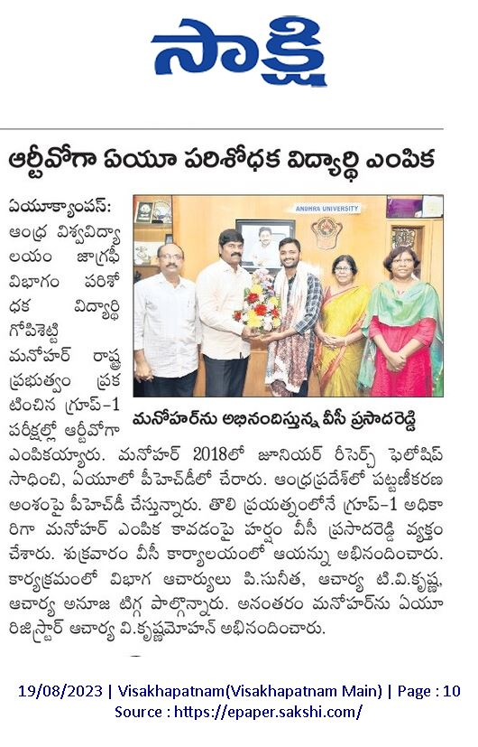

Slide 52
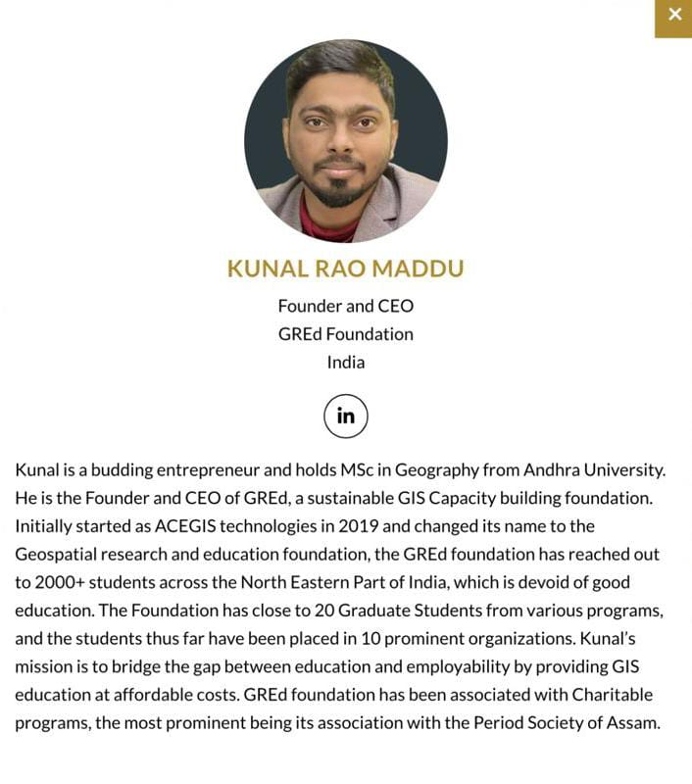
ENTREPRENEURSHIP

Slide 53
Prominent Alumni
Dr.Y.V.N.Krishna Murthy | Former Director – NRSC, Former Scientific Secretary, ISRO, Sr.Professor and Registrar IIST, Thiruvananthapuram
Sri. D.Pampathi Reddy (IAS) | Principal Secretary, Finance (Punjab Cadre)
Dr.V.Raghava Swamy | Former Deputy Director, NRSC/ISRO
Dr.P.V.S.P.Prasad Raju | Dy.Director ADRIN, DOS, Hyderabad
Dr.B.David (USA) | Director, National Center for Biodefense Communications at Jackson State University, USA
Prof.K.N.Prudhvi Raju | Geography & Geoinformatics, BHU
Sri.P.Raja Babu (IAS), | District Collector, Krishna Dt.

Slide 54
Prominent Alumni
Prof. S. Indira Devi | Prof.B.Mahalakshmi,
Prof.S.Sachi Devi, | Dr. VLN Sharma Dy. Registrar General (Map), Ministry of Home affairs, GOVT. of India.
Prof.P. Viswanadham, | Dr.V. Govindu IT Advisor, APSAC
Prof. M.Hari Krishna, | G.Manohar RTO, Govt. of AP
Prof.K. Nageswara Rao,
Prof.B.Hema Malini,
Prof. M.Sambasiva Rao,

Slide 55
Future Plans:
One year Diploma in Remote sensing & GIS (2023) in collaboration with All India Institute of Local Self- Government & technical collaboration with IIT, Bombay)
Initiated an MOU with APSAC to enhance learning/ training/ research/skill development.

Slide 56
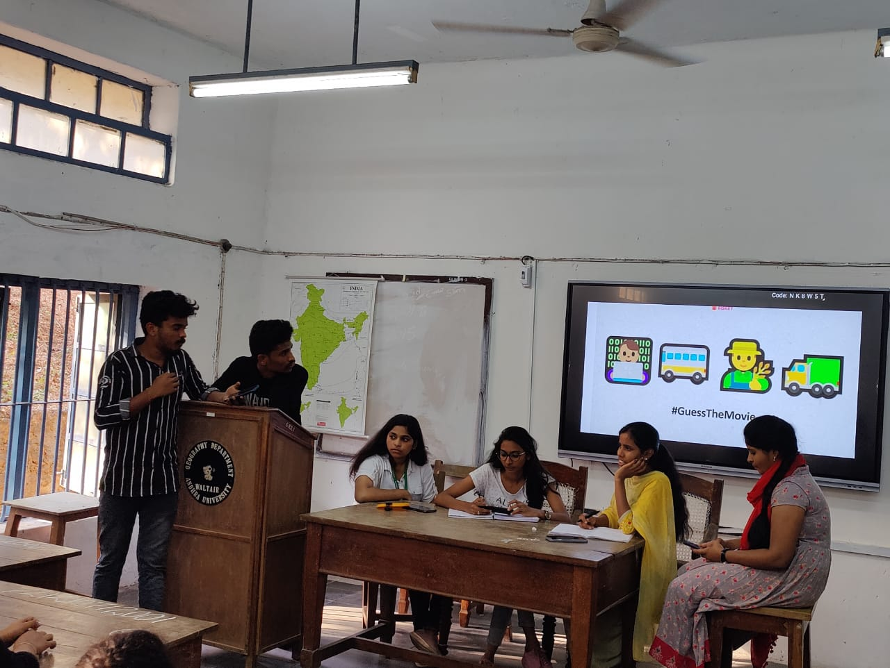
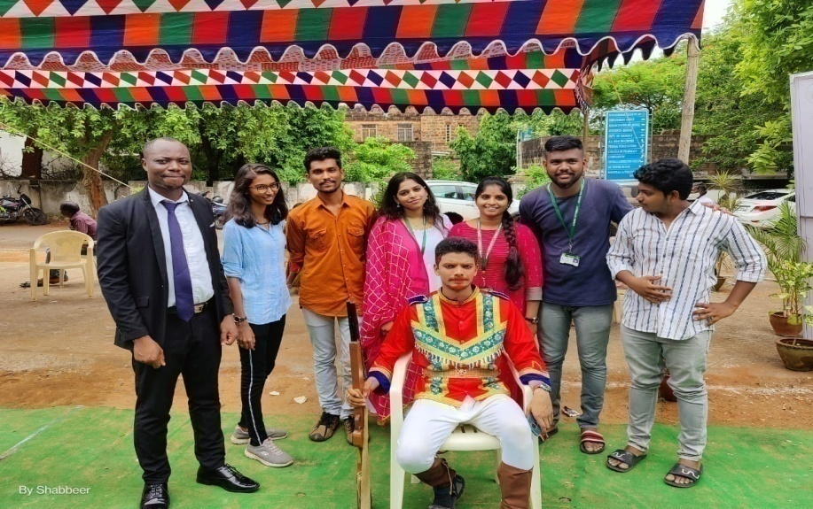
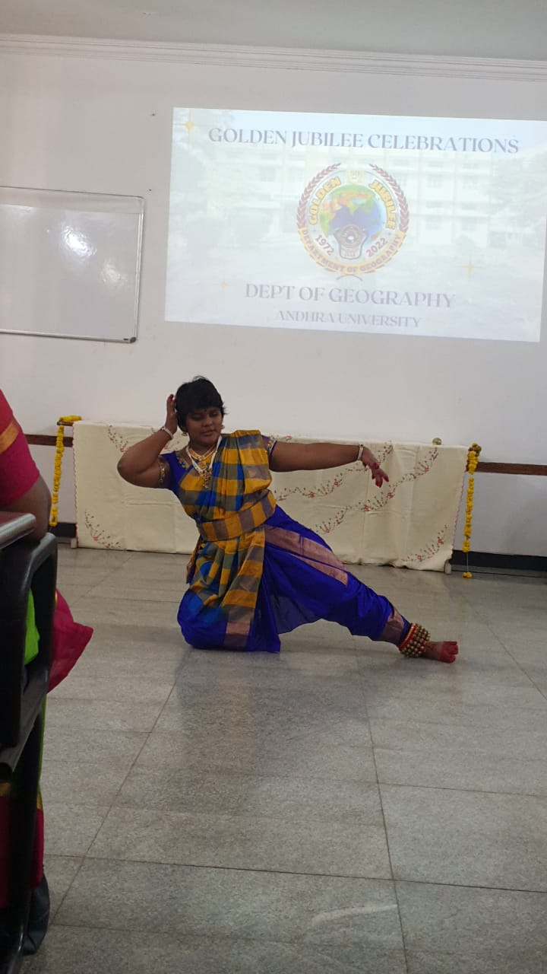
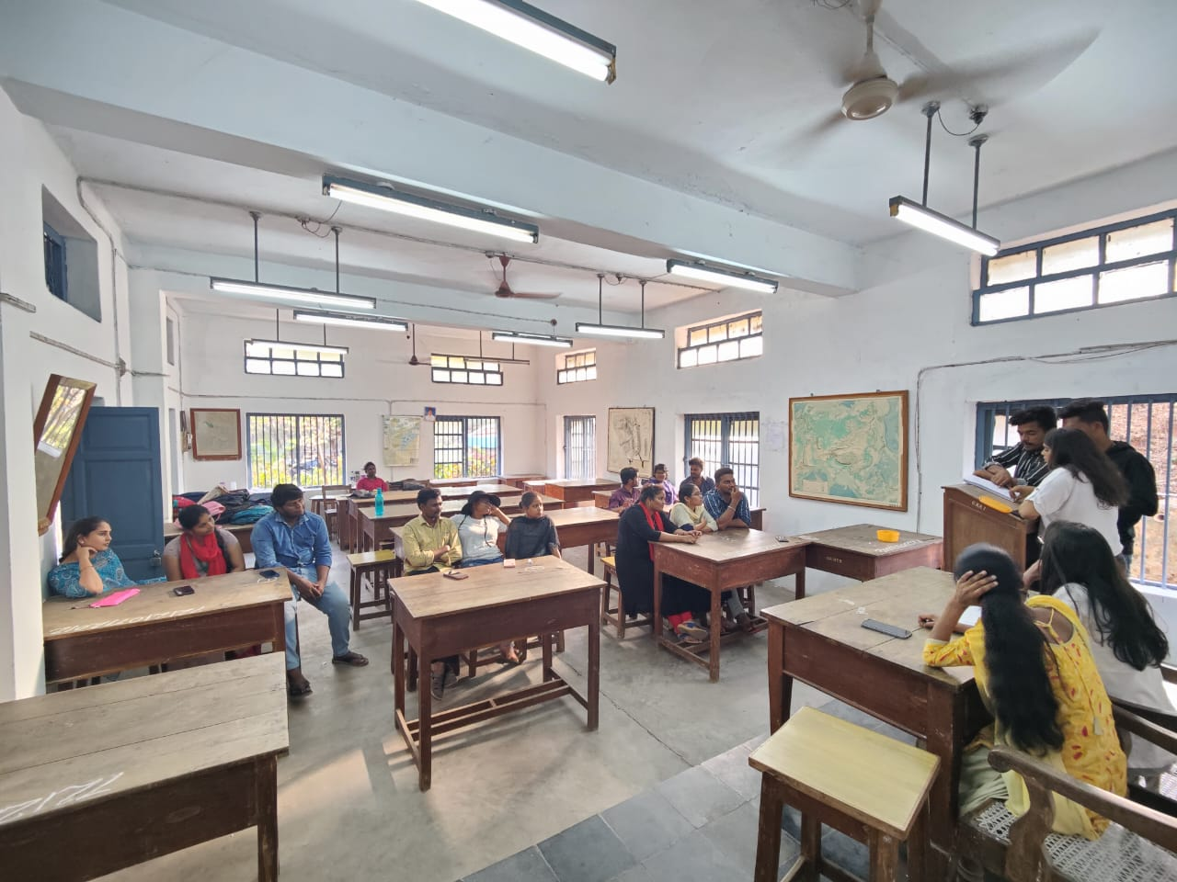
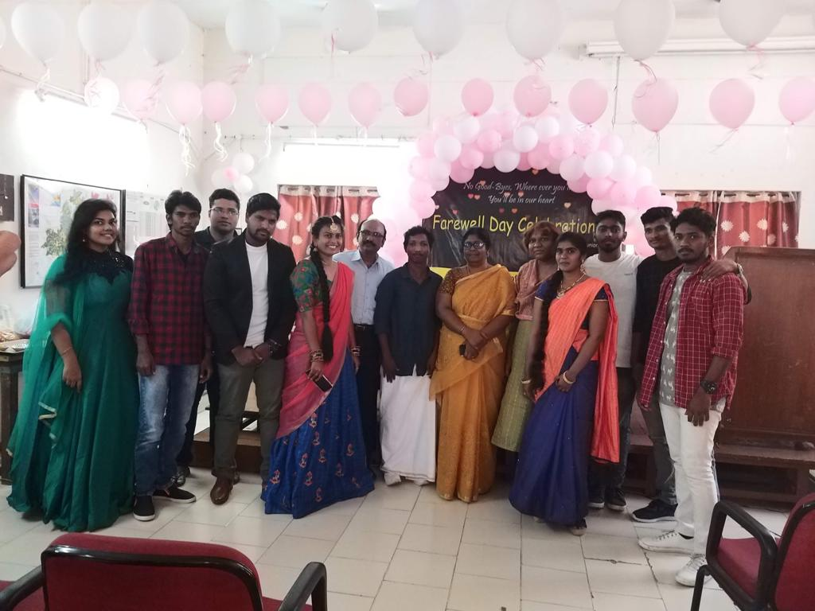
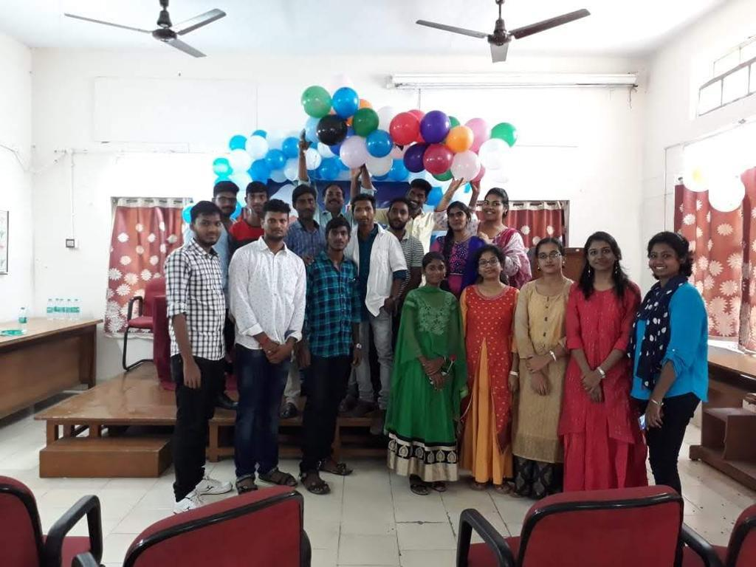
STUDENT ACTIVITIES

Slide 57
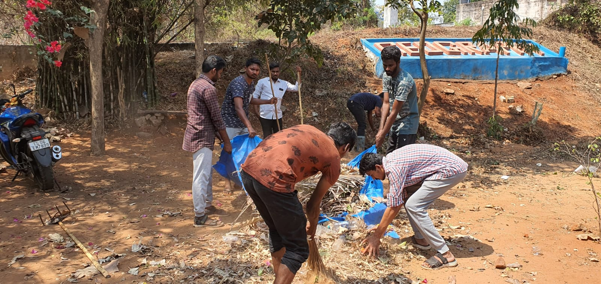
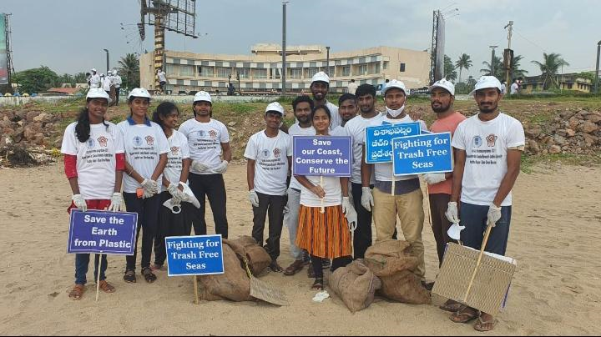
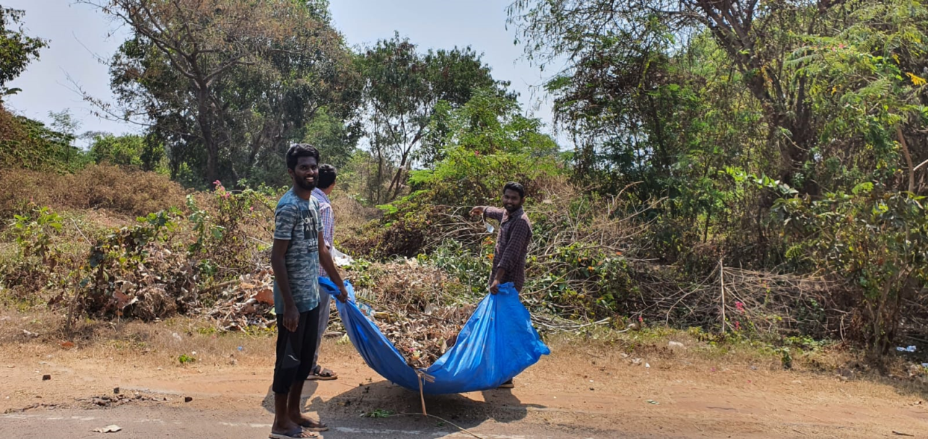

Slide 58
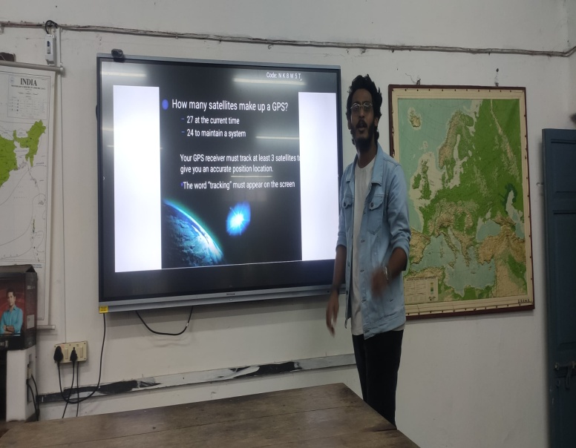
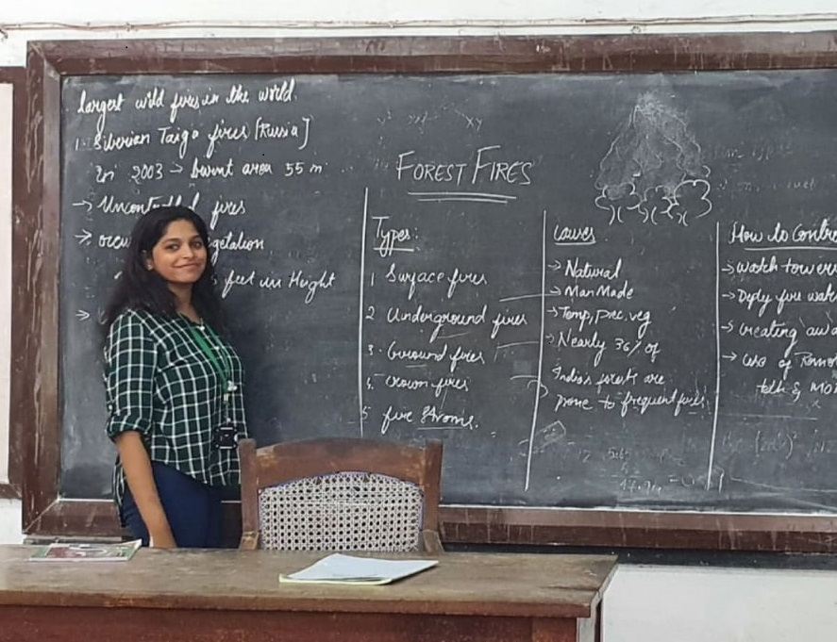
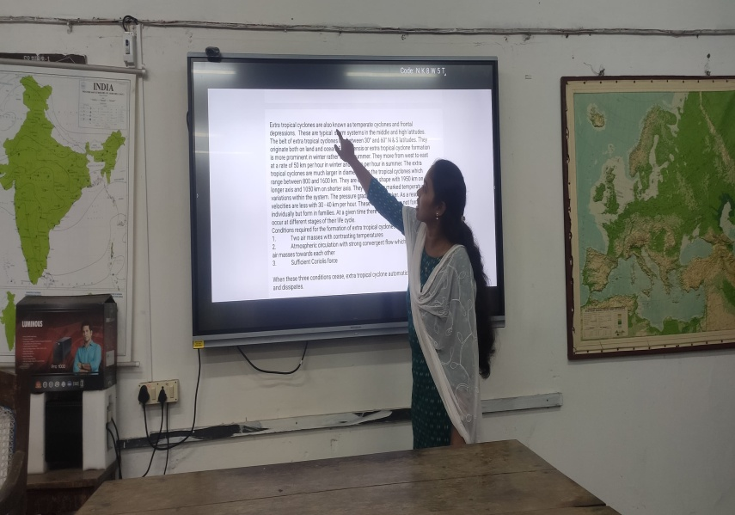
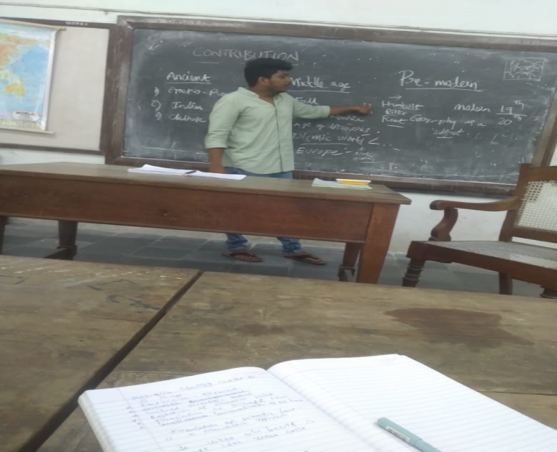
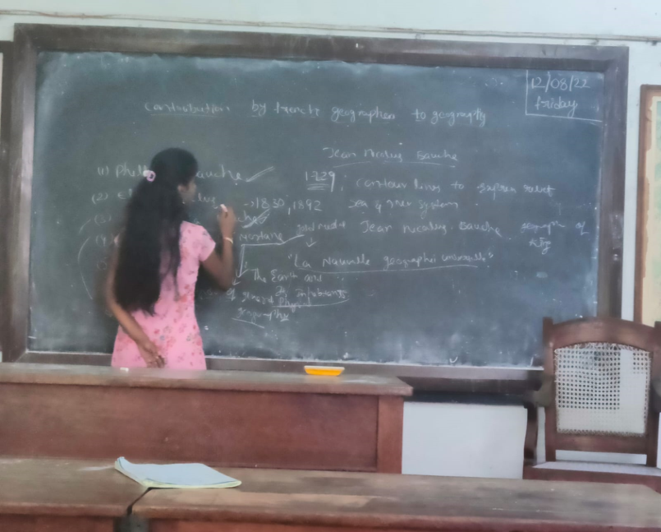
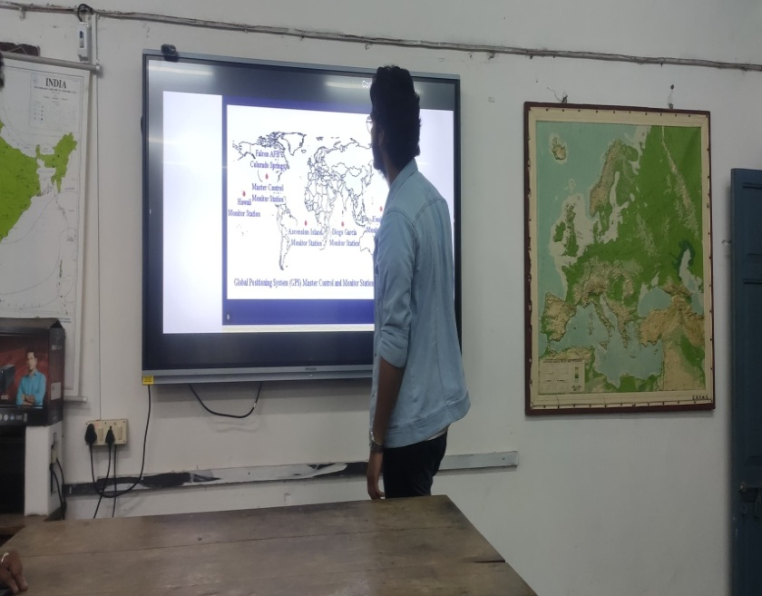
STUDENT SEMINARS

Slide 59
Students participation in various Competitions
Name | Compitition | Event,/Date | Organized by | Prize
Christopher Kicheek | Essay Writing | National Science Day, 28/02/2023 | Andhra University College of Science & TE | 1st prize
Christopher Kicheek | Elocution | National Science Day, 28/02/2023 | Andhra University College of Science & TE | 2nd prize
Christopher Kicheek | Elocution | Alluri Seetharama Raju Jayanthi 27/06/2022 | Centre for Alluri Seetharamaraju History & Tribal Studies | Special Prize
Christopher Kicheek | Paper presentation | 43rd IIG International conference | IIG & Osmania University | Presentation Certificate
Christopher Kicheek | Paper presentation | National Seminar | Department of Geography, Andhra University | Presentation Certificate
Sayyad Mohammad Shabbeer Ali | Thematic Quiz competition | Symposium 14/04/2023 | Ambedkar Chair, AU | 1st prize.
V.Divya Teja | Quiz | 74th Republic Day 26/01/2023 | Ambedkar Chair, AU | 3rd prize.
Sayyad Mohammad Shabbeer Ali | Quiz Competition | GIS Day 10-16, Nov, 2022 | Dept. of Geo Engineering, AU & RDT | 2nd prize
B. Dora Babu | Quiz Competition | GIS Day 10-16, Nov, 2022 | Dept. of Geo Engineering, AU & RDT | 2nd prize

Slide 60
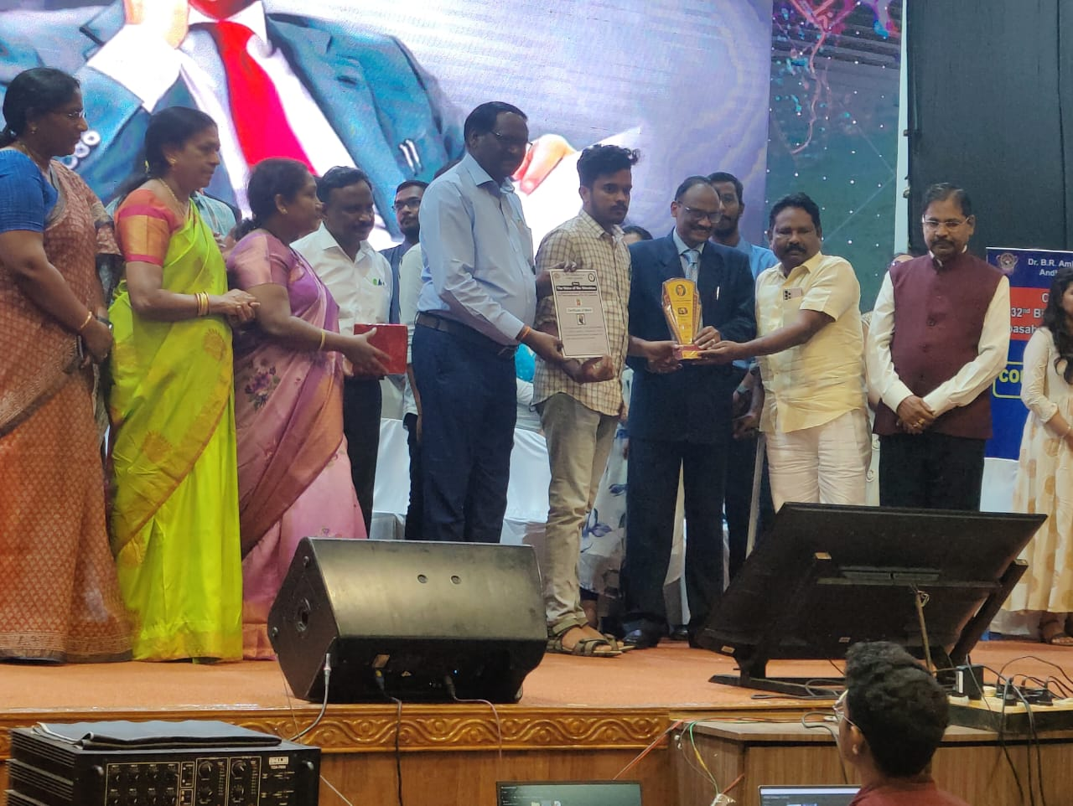
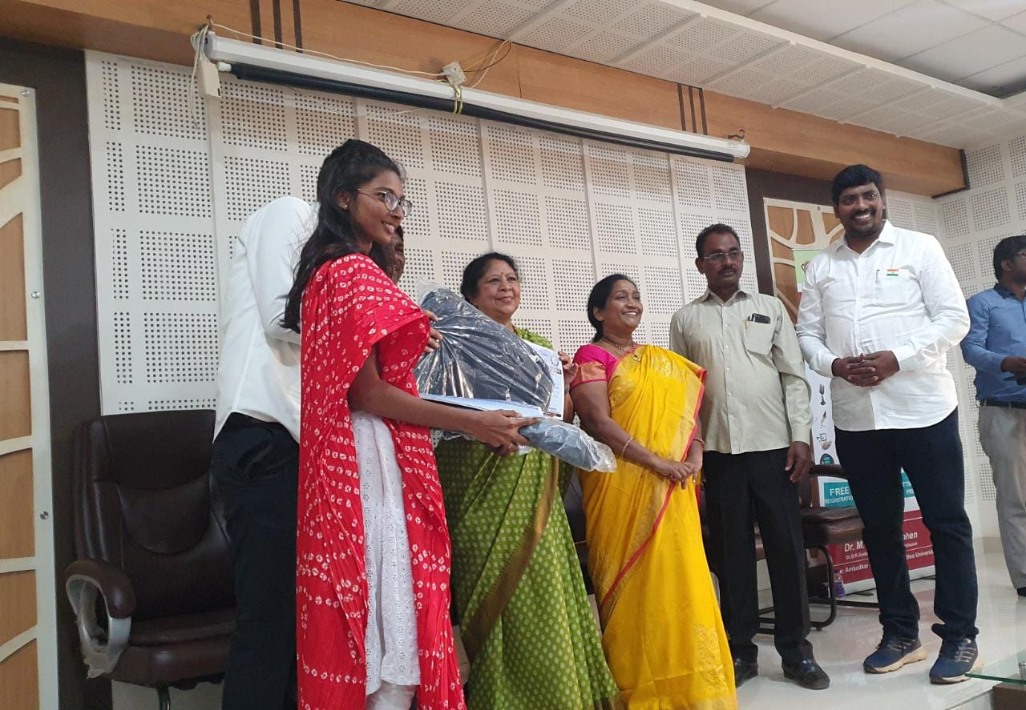
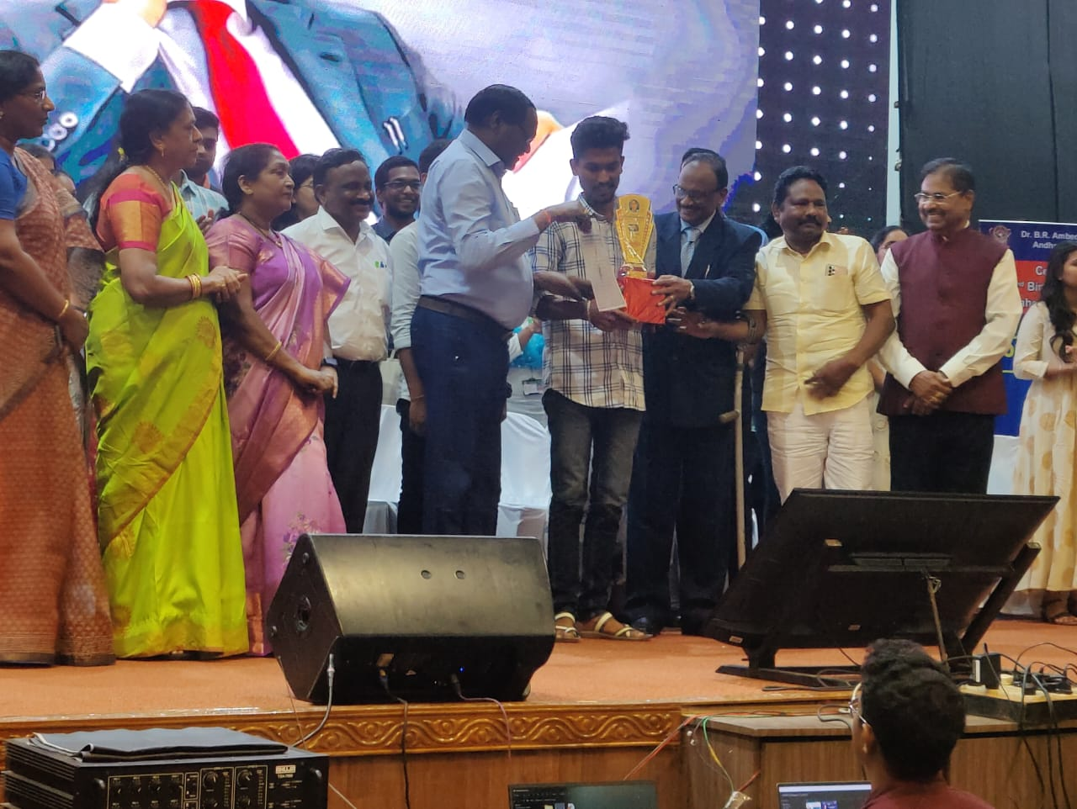
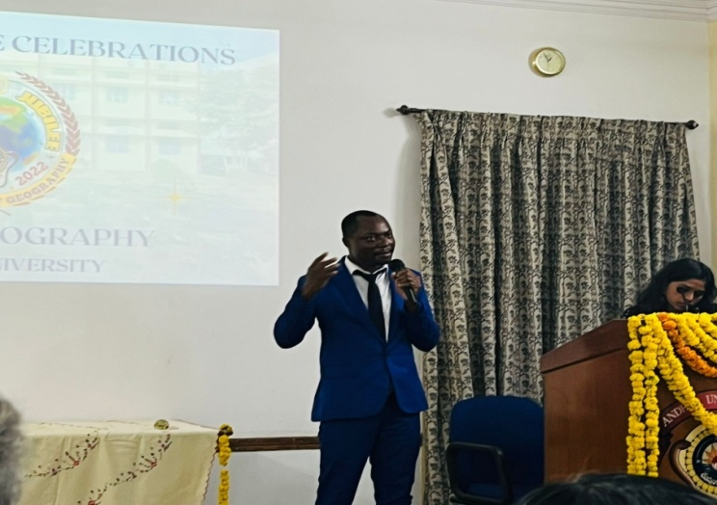
STUDENTS RECEIVING PRIZES IN VARIOUS COMPETITIONS

Slide 61
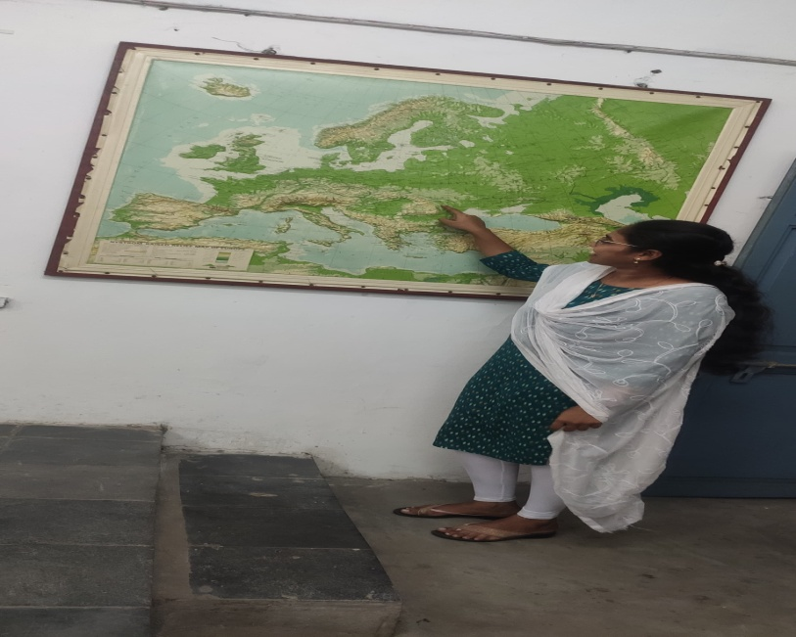
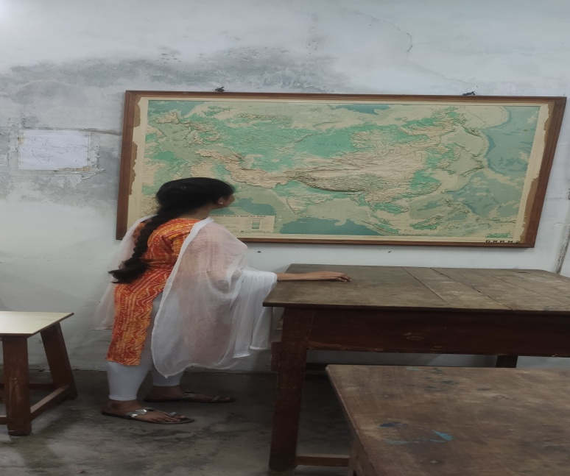
LEARNING THROUGH MAPS

Slide 62
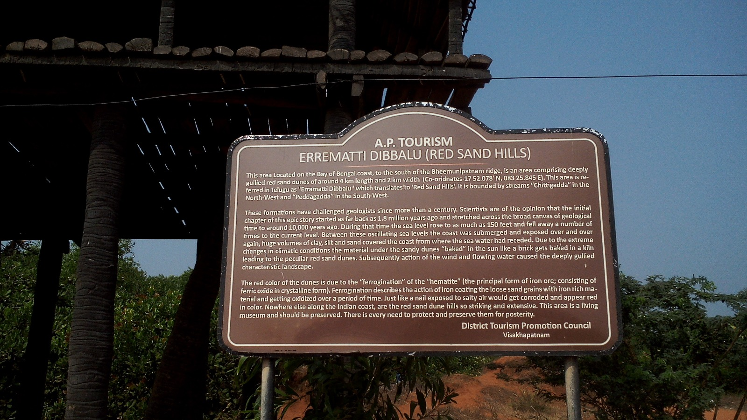
Field work

Slide 63
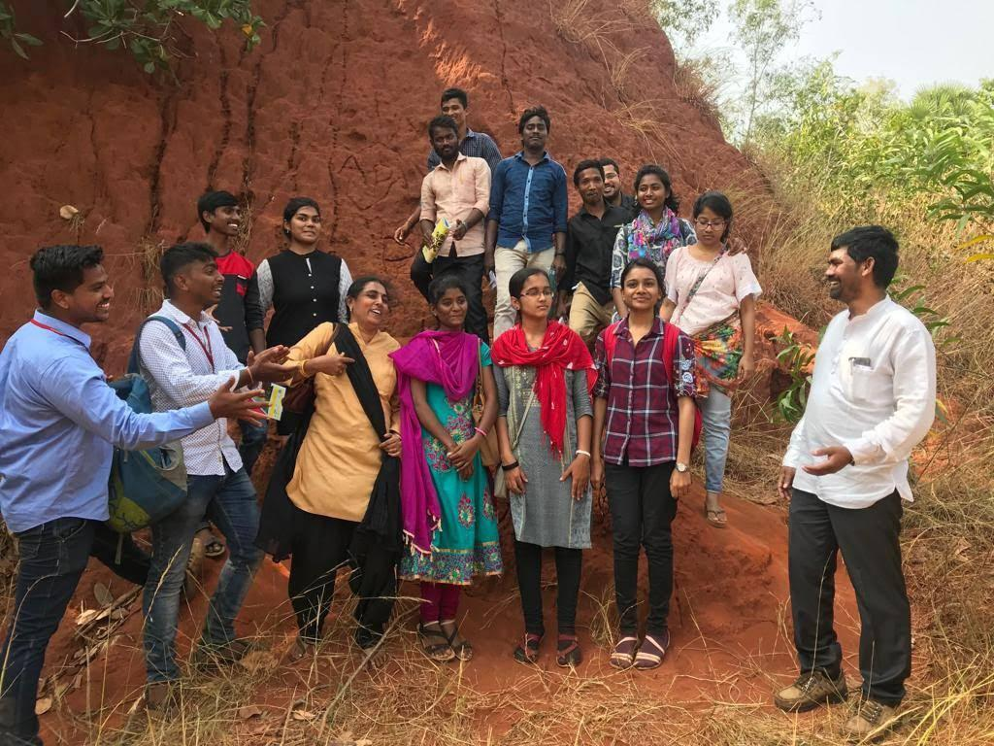
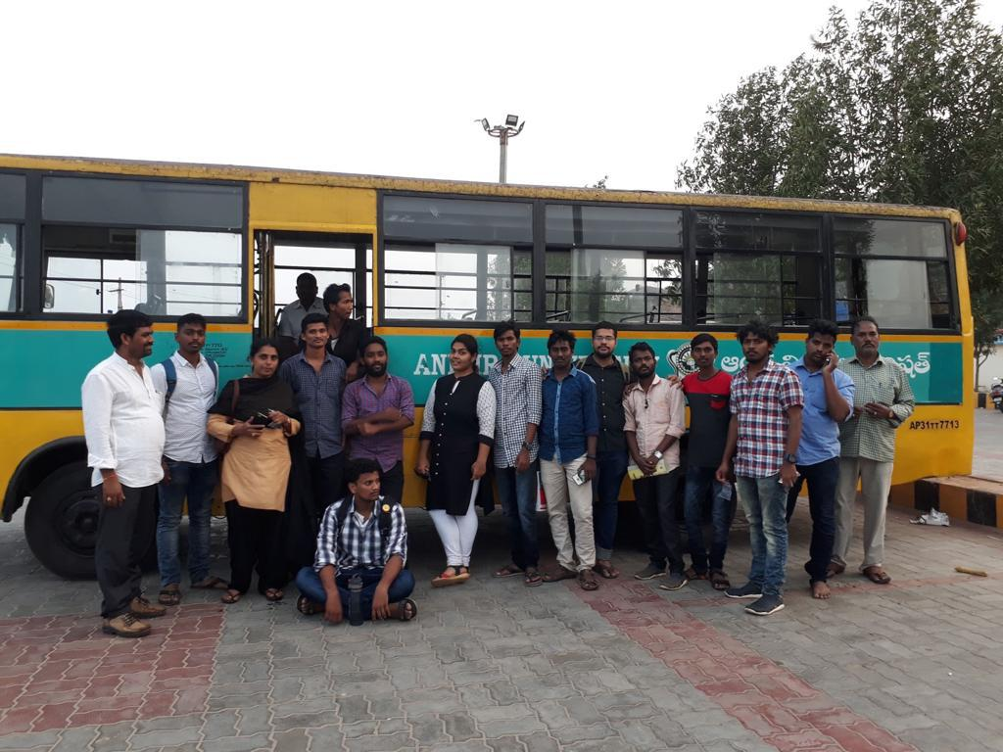
Bad land topography

Slide 64
Coastal Features

Slide 67
NATIONAL SEMINAR ON URBAN DEVELOPMENT AND ENVIRONMENT IN THE 21St CENTURY ISSUES &CHALLENGES

Slide 68
GOLDEN JUBILEE CELEBRATIONS 16,17,DECEMBER 2022

Slide 69
Thanks

